Slide 1

Hello TypeScript

Slide 2
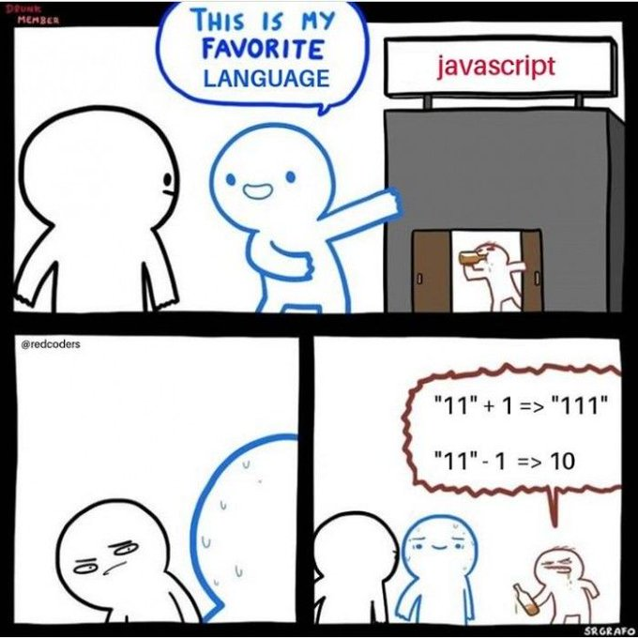

Slide 3
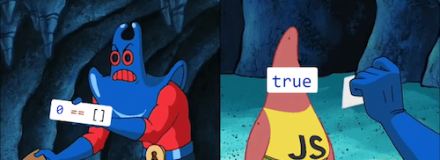

Slide 4
But
[5] == 5
isNaN([5, 2, 3])

Slide 5
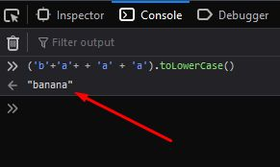

Slide 6
Why TypeScript
“We knew teams inside and outside of our company were having huge challenges with complex JavaScript codebases, and we knew that JavaScript was going to be used everywhere. So who wouldn’t want powerful tools to help write it?”
-- Daniel Rosenwasser, Ten Years of TypeScript

Slide 7
About TypeScript
Created by Anders Hejlsberg and a core team at Microsoft
First appeared in October 2012
Open source and developed out-in-the-open

Slide 8

TypeScript Design Goals

Slide 9
TypeScript “Parts”
TypeScript Language
TypeScript Compiler
TypeScript IDEs

Slide 10

Ready? Let’s Learn TypeScript
ynon@tocode.co.il
Https://www.tocode.co.il

